Slide 1
EVALUATION OF ANALYTICAL SCLABILITY
Presented by:
Bijali Jayalakshmi jayan

Slide 2
contents
Introduction
Convergence of analytic and data environment
Mpp
Cloud computing
Grid computing
Mapreduce
conclusion

Slide 3
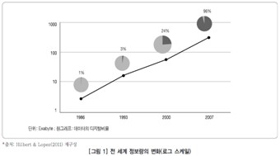
introduction
THE AMOUNT OF DATA ORGANIZATIONS PROCESS CONTINUES TO INCREASE

Slide 4
THE OLD METHODS FOR HANDLING DATA WON’T WORK ANYMORE.
IMPORTANT TECHNOLOGIES TO TAME BIG DATA TIDAL WAVE POSSIBLE:
MPP
CLOUD COMPUTING
GRID COMPUTING
MAPREDUCE

Slide 5
CONVERGENCE OD ANALYTIC AND DATA ENVIRONMENT
WE HAD TO PULL ALL DATA TOGETHER INTO A SEPARATE ANALYTICS ENVIRONMENT TO DO ANALYSIS
THE HEAVY PROCESSING OCCURS IN ANALYTIC ENVIRONMENT
MODERN IN DB ARCHITECTURE
THE PROCESSING STAYS IN DATABASE WHERE THE DATA HAS BEEN CONSOLIDATED

Slide 6
MPP
AN MPP DATABASES BREAKS THE DATA INTO INDEPENDENT CHUNKS WITH INDEPENDENT DISKS AND CPU
CONCURRENT PROCESSING
AN MPP SYSTEM ALLOWS THE DIFFERENT SETS OF CPU AND DISK TO RUN THE PROCESS CONCURRENTLY.
MPP SYSTEM BUILD IN REDUNDANCY TO MAKE RECOVERY EASY
MPP SYSTEM HAVE RESOURCE MANAGEMENT TOOLS
MANAGE THE CPU AND DISK SPACE
QUERY OPTIMIZER

Slide 7
CLOUD COMPUTING
MCKINSEY AND COMPANY
MASK THE UNDERLYING INFRASTRUCTURE FROM THE USER
BE ELASTIC TO SCALE ON DEMAND
ON A PAY PER USE BASIS

Slide 8
NIST:
ON DEMAND SELF SERVICE
BROAD NETWORK ACCESS
RESURCE POOLING
RAPID ELASTICITY
MEASURED SERVICE

Slide 9
PUBLIC CLOUD:
SERVICES AND INFRASTRUCTURE ARE PROVIDED OFF SITE OVER THE INTERNET
GREATEST LEVEL OF EFFICIENCY IN SHARED RESOURCES
LESS SECURED AND MORE VULNERABLE THAN PRIVATE CLOUDS

Slide 10
PRIVATE CLOUD:
INFRASTRUCTURED OPERATED SOLELY FOR A SINGLE OPERATION
SAME FEATURES OF PUBLIC CLOUD
OFFER THE GREATEST LEVEL OF SECURITY AND CONTROL
NECESSARY TO PURCHASE AND OWN THE ENTIRE CLOUD INFRASTRUCTURE

Slide 11
GRID COMPUTING
FEDERATION OF COMPUTER RESOURCES TO REACH A COMMON GOAL
EXAMPLS ARE:
SETI @ HOME (SEARCH FOR EXTRATERRESTRIAL INTELLIGENCE)
AN INTERNET BASED PUBLIC VOLUNTEER COMPUTING PROJECT

Slide 12
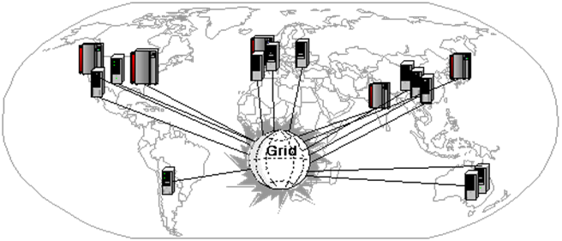

Slide 13
MAP REDUCE
A PARALLEL PROGRAMING FRAMEWORK
MAP FUNCTION
PROCESSING A KEY VALUE PAIR TO GENERATE A SET OF INTERMEDIATE KEY VALUE PAIRS
REDUCE FUNCTION
MERGING ALL INTERMEDIATE VALUES ASSOCIATED WITH THE INTERMEDIATE KEY

Slide 14
HOW MAP REDUCE WORKS?
LETS ASSUME THERE ARE 20 TERABYTES OF DATA AND 20 MAP REDUCE SERVER NODES FOR A PROJECT
DISTRIBUTE A TERABYTE TO EACH OF THE 20 NODES USING A SIMPLE FILE COPY PROCESS
SUBMIT 2 PROGRAMS (MAP, REDUCE) TO THE SCHEDULER
MAP PROGRAM FINDS THE DATA ON DISK AND EXECUTES THE LOGIC IT CONTAINS
THE RESULTS OF THE MAP STEPS ARE THEN PASSED TO THE REDUCE PROCESS TO SUMMERIZE AND AGGREGATE THE FINAL ANSWERS

Slide 15
GOOD FOR: =
LOTS OF INPUT, INTERMEDIATE AND OUTPUT OF DATA
BATCH ORIENTED DATA SETS (etl)
CHEAP TO GET UP AND RUNNING BECAUSE OF RUNNING ON COMMODITY HARDWARE

Slide 16
BAD FOR:=
FAST RESPONSE TIME
LARGE AMOUNTS OF DATA
CPU INTENSIVE OPERATIONS (OPPOSED TO DATA INTENSIVE)
NOT A DATABASE
NO BUILT IN SECURITY
NO INDEXING, NO QUERY OR PROCESS OPTIMIZER
NO KNOWELDGE OF OTHER DATA THAT EXISTS

Slide 17
CONCLUSION
THESE TECHNOLOGIES CAN INTEGRATE AND WORK TOGETHER
DATABASES RUNNING IN CLOUD
DATABASES INCLUDING MAP REDUCE FUNCTIONALITY
MAP REDUCE CAN BE RUN AGAINST DATA SOURCED FROM A DATABASE
MAP REDUCE CAN BE RUN AGAINST DATA IN THE CLOUD.

